Slide 1
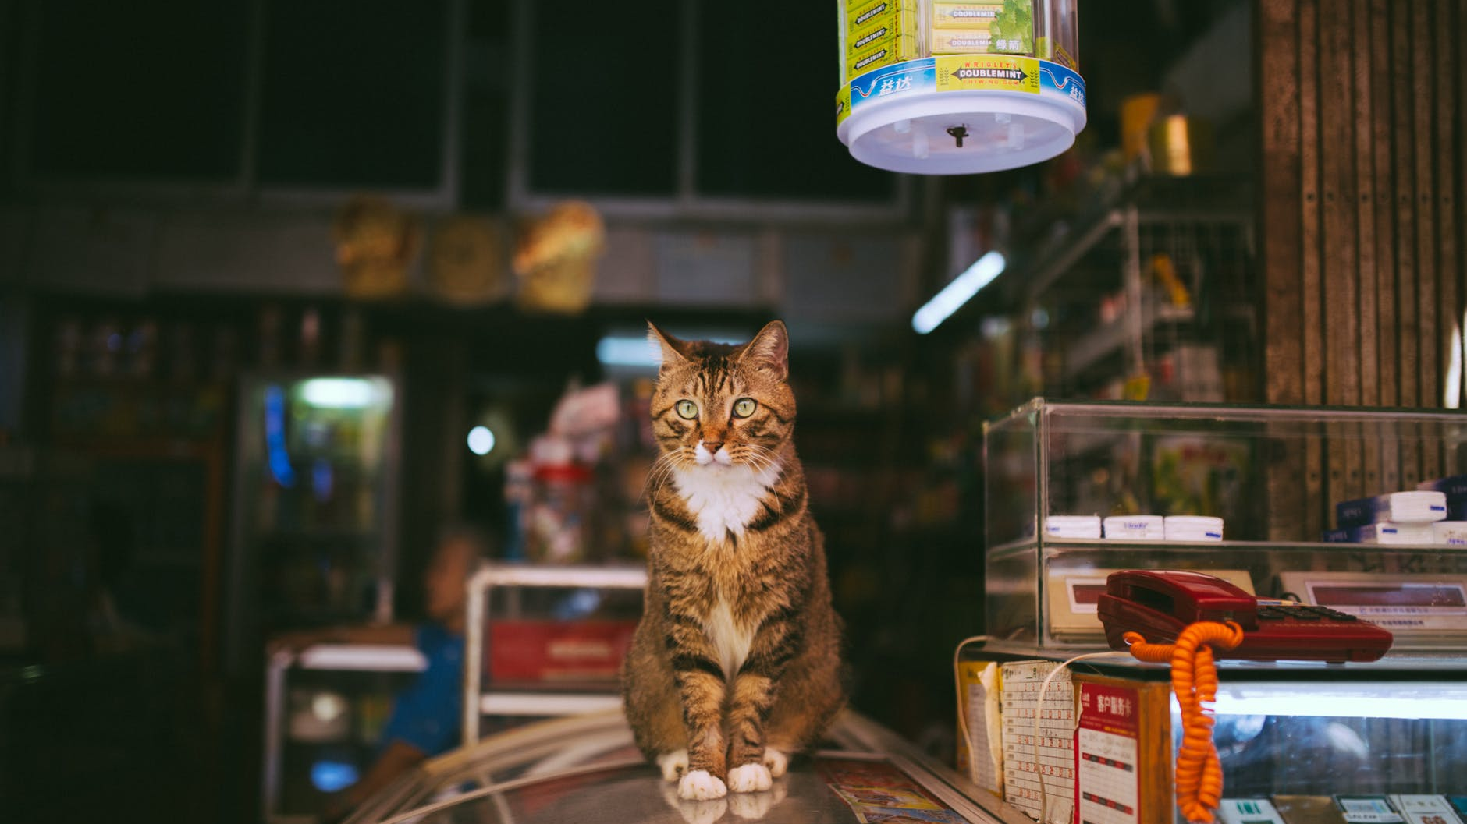
THE
CAT FEEDER
PROJECT
01
NEVER LET YOUR CAT ALONE

Slide 2
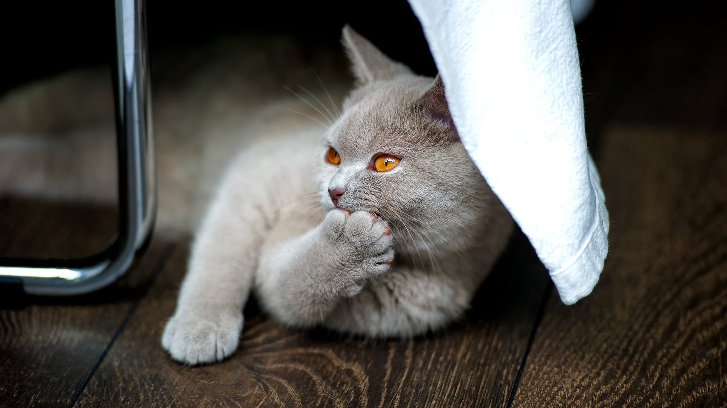
02
An application for empowering life of your cat?

Slide 3
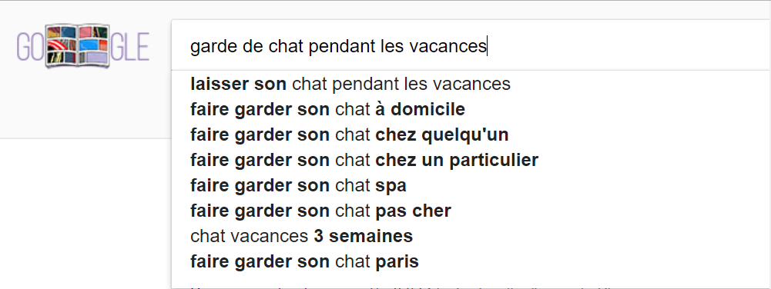
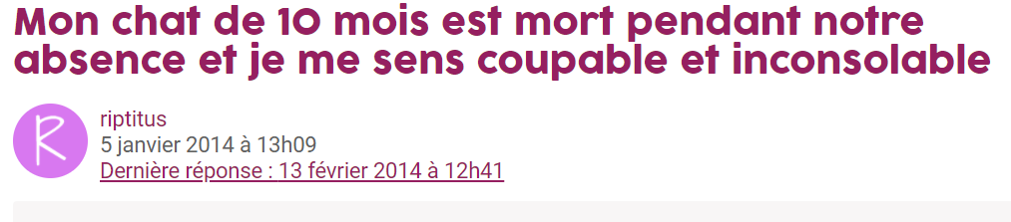
03
CONTEXTE
KEY OF MARKET IPSOS
HOW MANY PERSON ARE MADE THIS REQUEST ?
28 876 157 foyers recensés en France
58 % à estime que leur félin augmente leur bien-être
WE WANT TO LIMIT THE RISKS
Notes:
1 - 28 % possèdent au moins un chat, (soit plus de 8 millions de foyers)

Slide 4
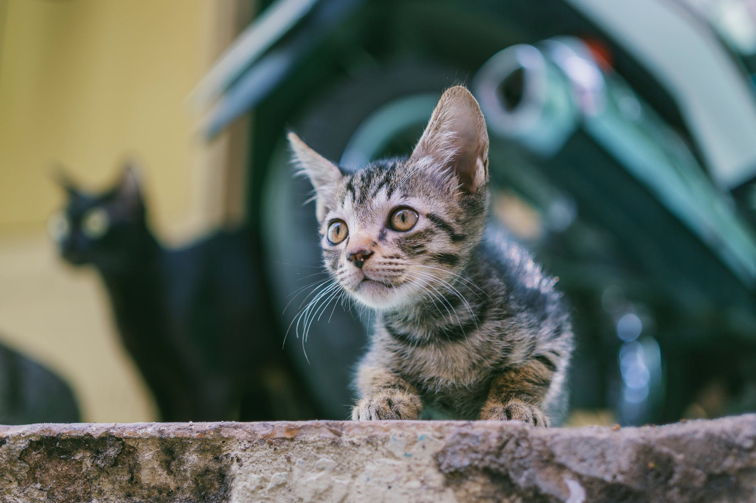
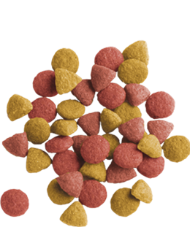

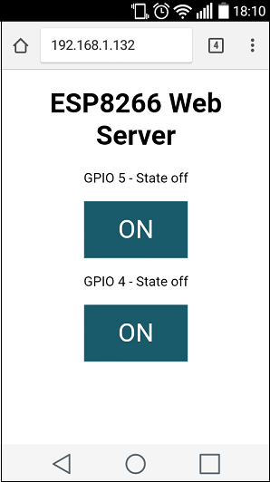


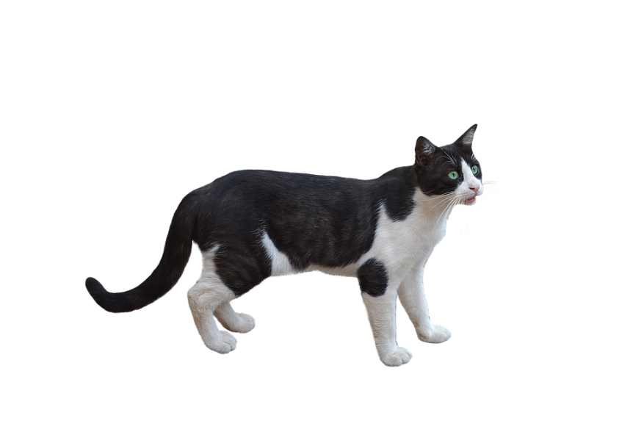
04
WHAT IS CAT FEEDER ?
Information sent to the database, with the hour date of reception.
The next step are to made a reporting of her cat food.
CAT FEEDER
1
Best services
2
Reduce cost
1 – Application for feed her cat
2 – Reduce the obesity of cat.
3 – Reduce cost of cat sitting

Slide 5
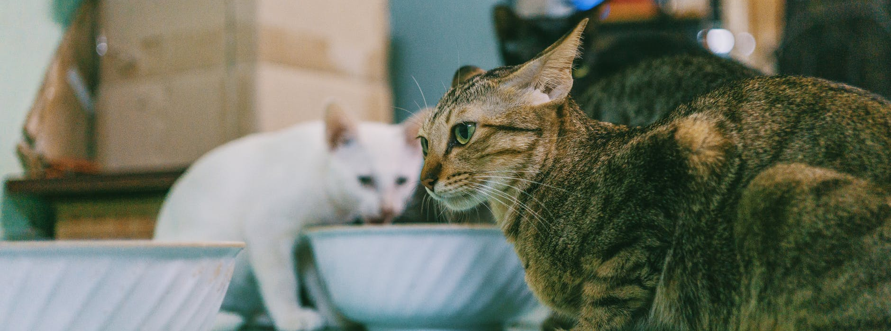
05
Analyze
1
Récupérer des variables sur l’heure, la pressions du bac a nourriture, faire des algorithmes prédictive adapté a vos besoins
2
Prenez en main votre chat

Slide 6

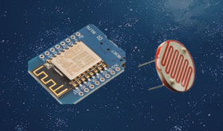
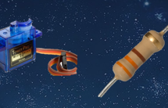
06
TOOLS
1 SENSOR
1 ESP
1 SERVO MOTOR
1 RESISTOR

Slide 7
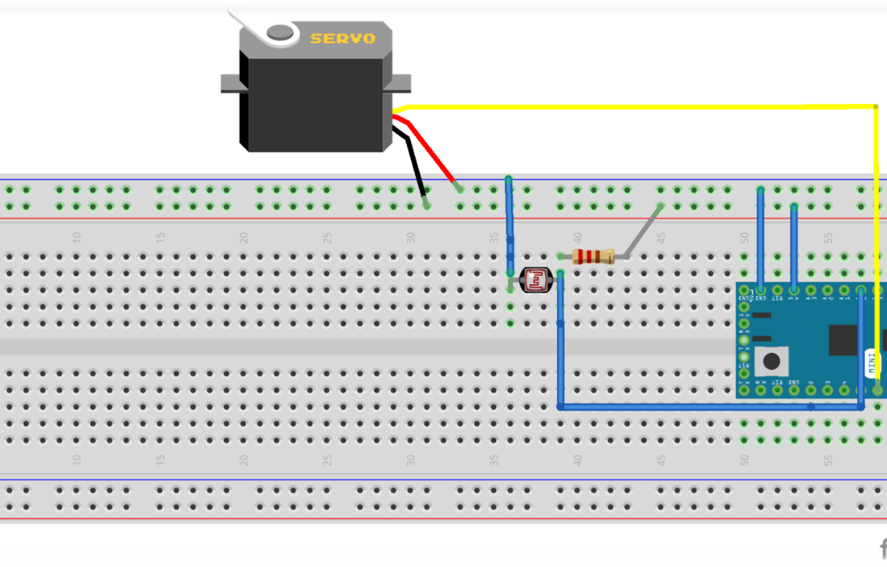
07
SCHEMA

Slide 8
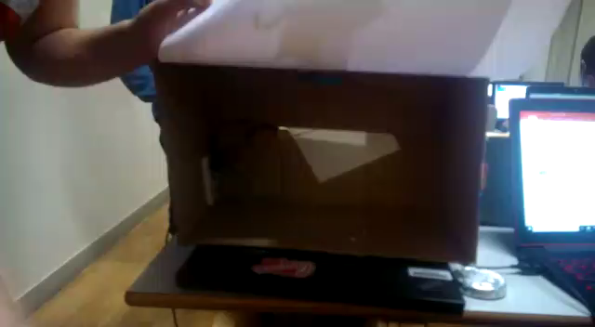
08
PRESENTATION

